Slide 1
Annual Conference 2021
The Role of Nanotechnology in Economic Development
Philipus N. Hishimone
Department of Physics, Chemistry & Material Science, School of Science, Faculty of Agriculture, Engineering & Natural Sciences, University of Namibia
340 Mandume Ndemufayo Avenue, Pioneers Park, Windhoek, Namibia

Slide 2
Introduction: Basic Human Needs
How do we provide better living standards to all people while minimizing the impact of human activities on the global environment and climate?
Notes:
To live and prosper on Earth, Every human being needs the following

Slide 3
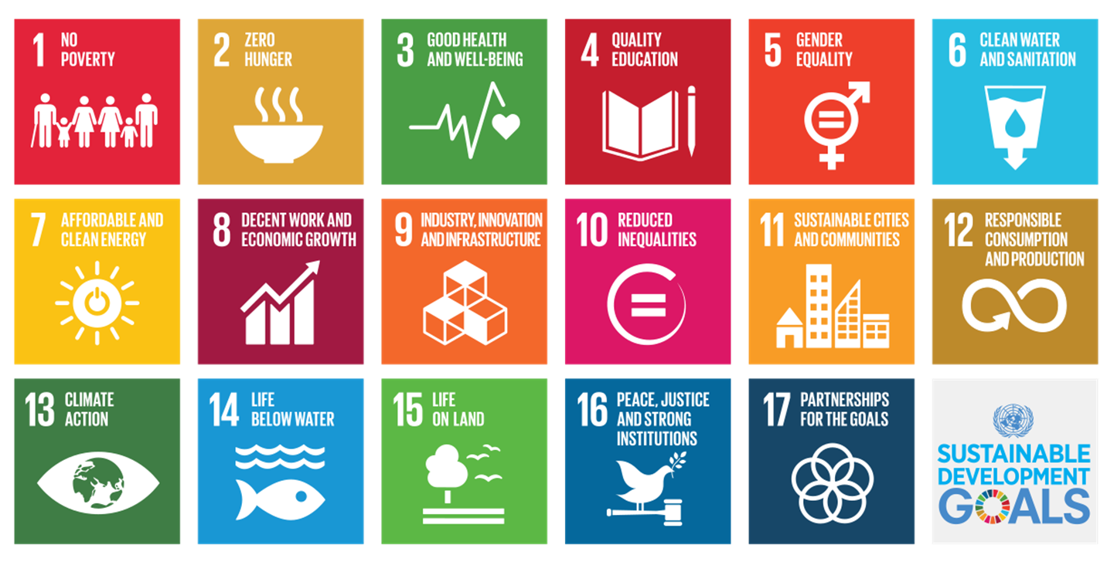
Introduction: the SDGs
Nanotechnology is deemed capable of providing more sustainable solutions to the global challenges facing society.

Slide 4
Introduction: Nanotechnology by definition
An applied science, focused upon exploiting novelties arising from size-dependent phenomena exhibited in nanoscale matter
⇨ Production and application of physical, chemical, and biological systems at nanoscale
⇨ Integration of the produced nanostructures into larger systems

Slide 5
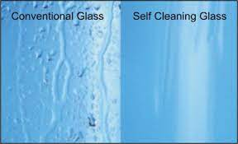
Introduction: Nanotechnology in Nature
The understanding of functions that allow various natural objects and processes to function on a micro- to nanoscale can guide us in imitating and producing nanodevices and nanomaterials.

Slide 6
Nanotechnology and the SDGs
Nanotechnology offers tools to develop new industries based on cost-effective and cost-efficient economies, thus seriously contributing to a sustainable economic growth
Notes:
By enabling smaller, faster, 'smarter', cheaper, lighter, safer, cleaner and more precise solutions

Slide 7
Nanotechnology in applications
⓵ Nanotechnology in electronics
1973
2030?
2018
As computers increase in power, the sizes shrink ⇒ Ability to cram millions of transistors on integrated circuit chips.

Slide 8
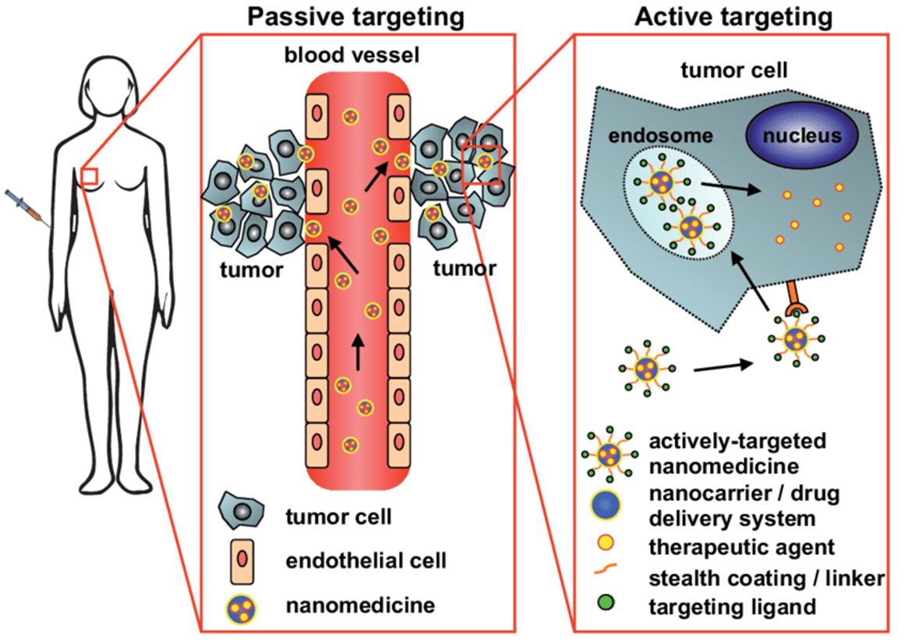
Nanotechnology in applications…
⓶ Nanotechnology in medicines
⇒ Improved imaging, localized therapy (enhanced treatment)

Slide 9
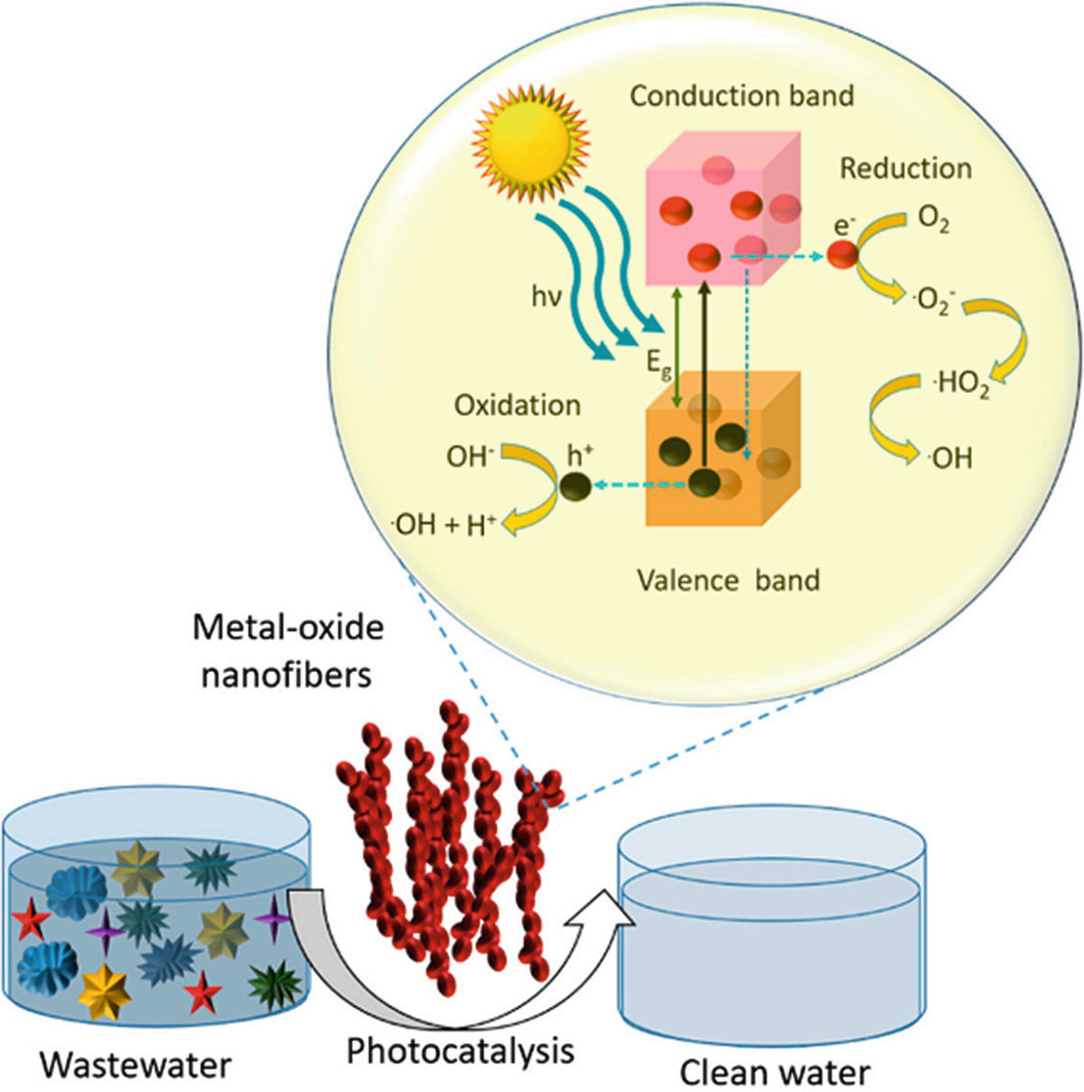
Nanotechnology in applications…
⓷ Nanotechnology in pollution control
⇒ Suitable for applications in rural areas
Ali Z., Ahmad R. Env. Nanotech., 3 (2020)

Slide 10
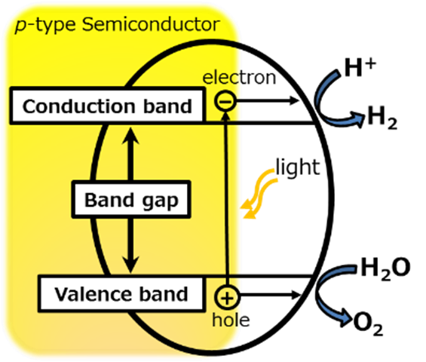
Nanotechnology in applications…
⓸ Nanotechnology in energy production & storage
Green Hydrogen?

Slide 11
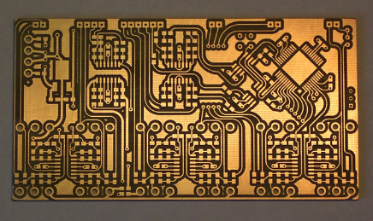
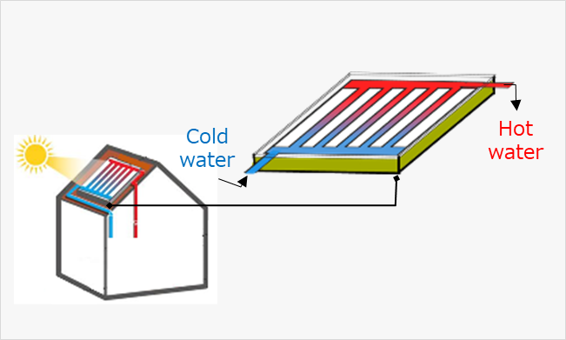
Nanotechnology in applications…
Some other applications
Electrical conductors
Solar thermal collectors
Antimicrobial touch surfaces

Slide 12
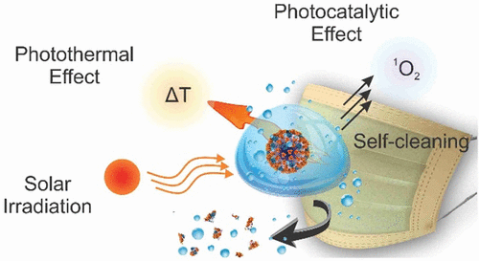
Nanotechnology in applications…
Some latest developments

Slide 13
The Namibian perspective: Nanotechnology?
How can Namibia actively participate in Nanotechnology?
Lets’ use the figure below as an example
D. W. Hobson, WIREs Nanomedicine and Nanobiotechnology, 1 (2009)

Slide 14
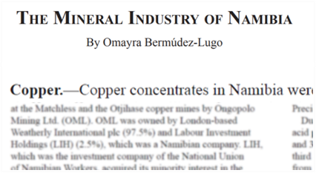
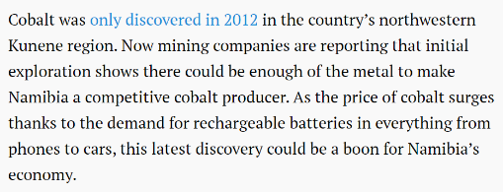
The Namibian perspective: Nanotechnology?...
Natural resources in Namibia
Namibia, known for diamonds and deserts, wants to get in on the rechargeable battery boom
Most mining products are exported from Namibia with little on no value addition.

Slide 15
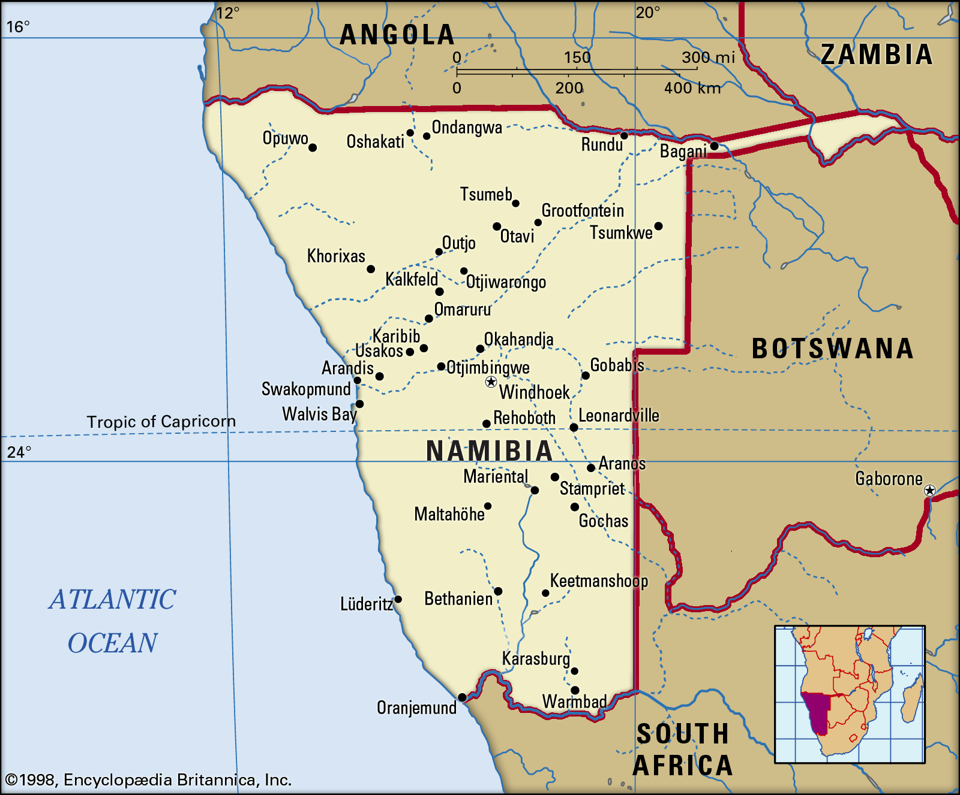
The Namibian perspective: Nanotechnology?...
Unique Land, Unique Challenges: Can Nanotech. solve?

Slide 16
The Namibian perspective: Nanotechnology?...
Using the Namibian natural resources, we can manufacture nanotechnology-based products that are tailored for solving Namibian problems.
National Nanotechnology Initiative? For Namibia?
“With all of us working together, we can create a Namibian Society around the 4th Industrial Revolution and into the future”
∼ ...
Notes:
Focus on nanomaterials

Slide 17
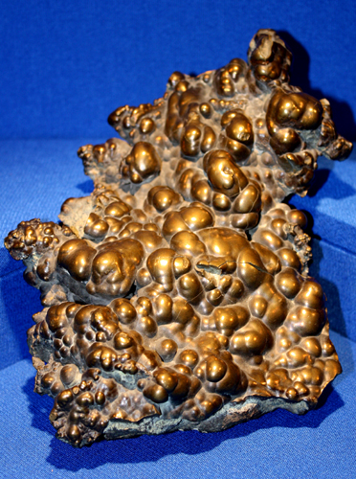
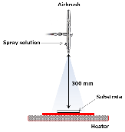
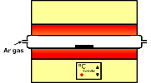
The Namibian perspective: Our work
Functional thin films fabrication from Namibian resources, in Namibia.
Example: Thin films of copper
General protocol
Exported for processing
Blister Copper
Copper(II) Salts
Copper(II) complex of EDTA
Our new plan
Solving
Blister Copper
Precursor Solution
Spray-coating
Heat-treatment
Thin Film
I believe that the research work in this thesis will be of great contribution to the industrialization of Namibia.
Notes:
Focus on nanomaterials

Slide 18
Thank you for your kind attention!
Notes:
Focus on nanomaterials

